Slide 1
Automatic Fire and Gas Alarm
System
CSE - 306 Microprocessors, Micro-controllers and Assembly Language Project Final Submission Group - 29

Slide 2
Group Members
201814107 --- [ Lt. Salman Rahman ]
201914056 --- [ A.S.M. Rakibul Hasan ]
201914024 --- [ Shad Reza ]

Slide 3
Automatic fire and gas alarm system
Components
ARDUINO UNO…………….. 1 pcs
FLAME SENSOR…………... 1 pcs
MQ-4 GAS SENSOR……..... 1 pcs
LCD 16X2………………….... 1 pcs
BUZZER……………………... 1 pcs
NPN Transistor…………….... 1 pcs
LED-RED…………………….. 1 pcs
LOGIC TOGGLE…………….. 2 pcs
GROUND…………………….. 3 pcs
TERMINAL Vcc POWER…... 2 pcs
WIRE…………………………. As Per Requirement

Slide 4
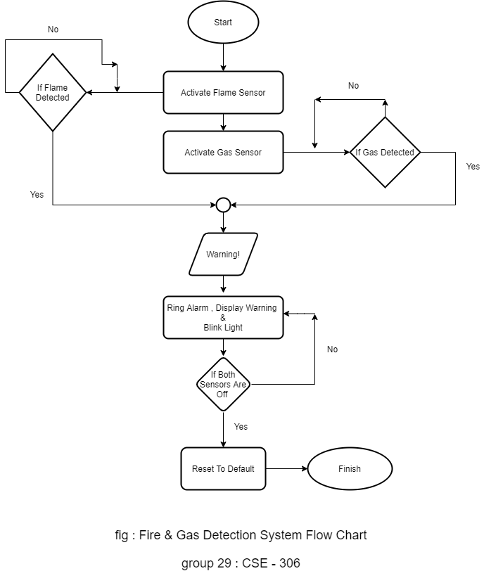
FlowChart

Slide 5
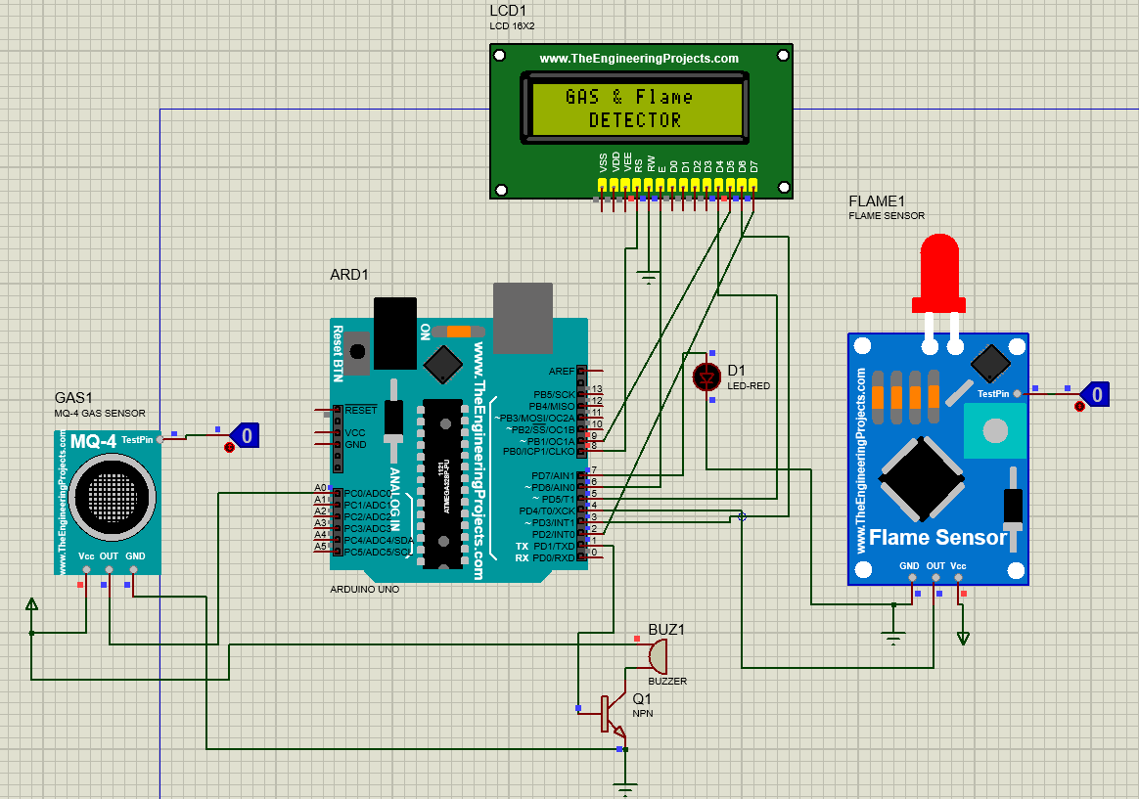
The Proteus Project

Slide 6
Work Procedure
MQ-4 Gas Sensor For the gas sensor we have chosen the MQ-4 gas sensor that needs the power in it’s Vcc terminal. Also it needs to be connected to the ground through the GND point. For it’s input as we are in software simulation so there is a logic toggler that is connected to the TestPin of the MQ-4 which really acts like the input sensing. Lastly The OUT or the output terminal is connected to the A0 pin of the ARDUINO UNO.

Slide 7
Work Procedure
Flame Sensor
Similarly like the MQ-4 gas sensor the Flame sensor also has GND or ground point that needs to be connected to the ground and for the power Vcc we have to infuse the power from that point. For the input it also has a TestPin that feeds the input and works as the overall sensing. And for the output the the OUT terminal of the flame sensor is connected to pin no 4 of the ARDUINO UNO.

Slide 8
Work Procedure
LCD Display 16x2
For the display side we see that the Liquid Crystal Display has its own pin arrays that are connected with the ARDUINO UNO’s pins. Here the ARDUINO’s 8, 6, 5, 9, 3, & 2 these pins are connected to RS, E, D4, D5, D6 & D7 pins of the LCD display. And there is a ground being connected to RW pin.

Slide 9
Work Procedure
Additionals
As for the buzzer alarm we have taken a buzzer that needs support from the npn transistor and also a Red LED is used which will be our alarming & warning method. Also The LCD display will show us the warnings as well.

Slide 10
Work Procedure
ARDUINO UNO
For the arduino code we have first of all included some necessary headers and done some proper initializations and some definition and variable settings like, setting the MQPin to A0 of arduino, defining the buzzer with pin-1, setting the LED with pin-7, flame sensor with pin 4 and taking a variable called flame that will get the output from the digitalReading from pin 4.
Next in the setup method we are initializing all the necessary setups that we need to start the process. Meaning activating the components. Here the setting the input output pin for the flame sensor and same for the gas sensor. Also the buzzer and the LCD has to be initialized here as well.
Now Going in to the loop method we are always waiting for the inputs from any of the sensors that will eventually trigger the LED and also the Buzzer Alarm. Also the display will show the information of hazard that has triggered the situation.

Slide 11
Features
Detects both gas & flame
For any of the triggering we will get the alarm buzzing, LED flashing & proper cause of the hazard in the LCD display
Without terminating the simulation this system can detect the hazards each and every time flawlessly and no other reset option needed

Slide 12
Thank You!

